Slide 1

“My health” IA research (tree test)
January 2023 Mikki Northuis, Lead IA, OCTO-DE

Slide 2

How this research maps to the Veteran journey
Title of the research | mm dd, yyyy
Attending to health needs
Recognizing and addressing mental health needs
Managing primary care and chronic health issues
Taking care of my health
Managing my declining health
Reinventing myself
Joining
Serving
Getting out
Starting up
Taking care of myself
Retiring
Aging
Dying
Putting down roots
For a fully detailed Veteran journey, go to https://github.com/department-of-veterans-affairs/va.gov-team/blob/master/platform/design/va-product-journey-maps/Veteran%20Journey%20Map.pdf
Serving and separation
Living civilian life
Retiring and aging

Slide 3
OCTO-DE goals that this research supports
Title of the research | mm dd, yyyy
Supported
Not supported
Veterans and their families can apply for all benefits online
Veterans and their families can find a single, authoritative source of information
Veterans and their families trust the security, accuracy, and relevancy of VA.gov
Veterans can manage their health services online
VFS teams can build and deploy high-quality products for Veterans on the Platform
Logged-in users have a personalized experience, with relevant and time-saving features
Logged-in users can update their personal information easily and instantly
Logged-in users can easily track applications, claims, or appeals online
Completion rate of online transactions
Percent of applications submitted online (vs. paper)
Veteran satisfaction with VA.gov
Benefit use and enrollment, across all business lines
Benefit value (in $) delivered from online applications or transactions
Number of VA.gov users as a function of total Veteran population
Usage of digital, self-service tools
Measures to increase
Time to successful complete and submit online transactions
Time to process online applications (vs. paper)
Call center volume, wait time, and time to resolution
Time from online benefit discovery to benefit delivery
Measures to decrease

Slide 4
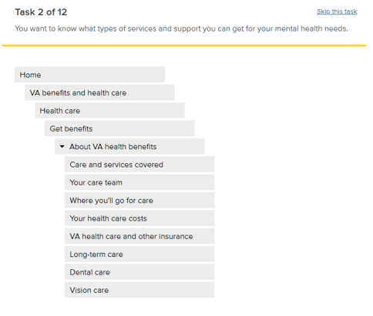
Methodology
We utilized an online tool called Treejack developed by Optimal Workshop
This tool allows us to collect data on how participants navigate a menu structure to find the answers to questions/tasks
Participants were asked to complete 10 tasks by navigating a menu structure and indicating where they would be able to find the answer
Participants were started at the top of the menu for each task with the menu fully collapsed
Tasks were randomized to avoid bias from learning the tree as the test progressed
Example tree test task

Slide 5
Participants
6 cohorts of Veterans - 45 completions
23 have used MHV in last 12 months
22 have not used MHV in the last 12 months (not required to have VA health care)
54 attempted, 10 abandons, 4 removed
Demographics requested
Participants recruited represented a diverse sample of Veterans composed of varying ages, races, genders, geographical locations, education levels, and cognitive abilities.
Optimal workshop does not currently support assistive screen readers, so participants that utilize assistive tech were not recruited in this test.
Notes:
Cohorts 1-3 = Have used MHV in last 12 months, VA health care required
Cohorts 4-6 = Have not used MHV in last 12 months, VA health care not required

Slide 6
Topics and structure tested
Tasks were chosen to represent a mix of key content located within various sections of the experience. The structure presented focused on core features.
Task | Target content
1. You drove to see your VA primary care physician and want to get paid back for the cost of gas. | Travel pay
2. You saw your primary care provider last month and want to review what was decided for next steps in your care. | After-visit summary
3. You need to request a refill for a prescription you get from VA by mail. | Prescription refills
4. You want to know the name of the prescription that you stopped taking last summer for a skin condition. | Expired prescription
5. You want to find the results of a recent MRI you had done. | Medical images
6. You need to know when you had your last tetanus shot. | Vaccine history
7. You want to know what your blood pressure was the last time you had it taken at a VA medical facility. | Recent vitals
8. You want to get a copy of your VA health records for your personal files. | Medical records
9. You need to order new batteries for your hearing aid. | Hearing aid batteries
10. You recently lost your ID card for your Veteran health care and need to get a new one. | Veteran ID card
Information architecture – top level
My Health
 | Appointments
 | Messages
 | Medications
 | Test results
 | Copay bills
 | Medical equipment and supplies
 | Health history
 | Medical records
 | My health benefits
 | News and events

Slide 7
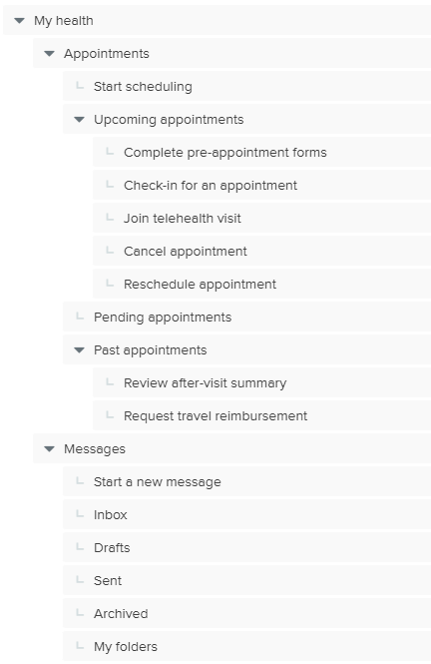
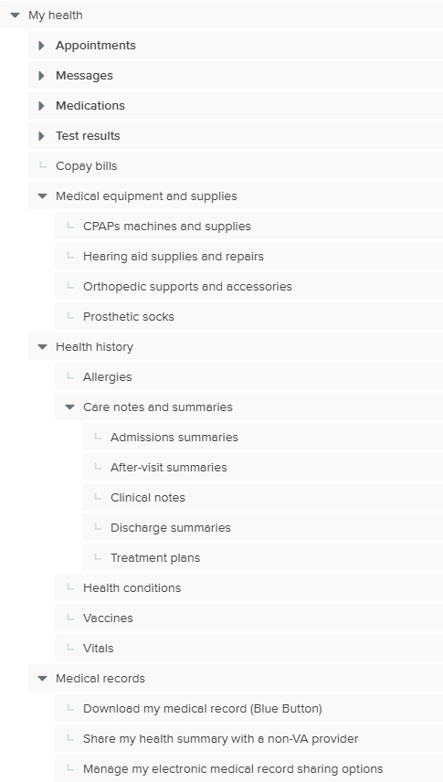
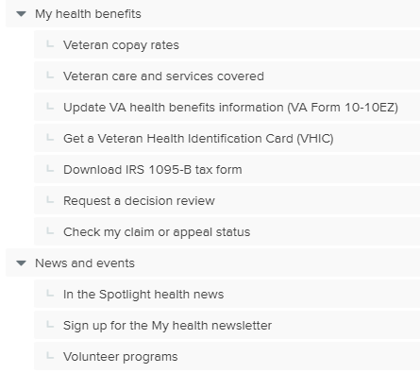
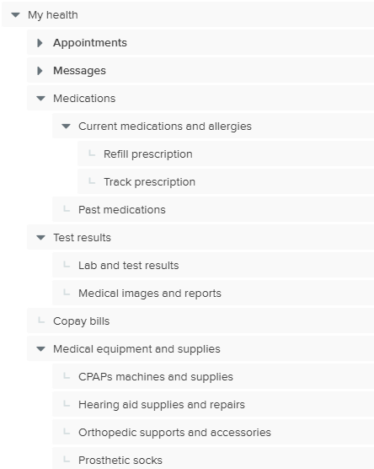

Slide 8
Common metrics and data points in tree tests
First click/click paths
The first clicks a participant makes generally indicates where they expected to find the information
Deeper click paths can show you where participants believe information should be, and where they are getting hung up
Success rates and Directness
Success rate = The percent of participants that selected the correct answer, regardless of how they got there.
Directness = The percent of participants that went directly to an answer without backtracking, regardless if the answer was right or wrong
These 2 metrics are most often looked at together when analyzing a tree test
High success with low directness indicates that participants bounced around to find the answer, the path or the answer wasn’t clear
Low success and high directness indicates that participants went directly to the wrong answer, they had high confidence in incorrect selections
Other metrics used in tree testing - i.e. time taken per task, skip rate, etc – can also be indications of where things are challenging
It’s not about the pass/fail of a task, it’s about the insights we collect!
Failed tasks provide helpful insights in what is and is not working
Always keep in mind that all labels and parts of a structure can impact a tasks results. For example, a section of the tree may be perfectly labeled and structured, but if another part has a misleading label, it can draw visitors away.

Slide 9
Key findings
The different sections containing health and medical records information had some overlap in meaning, but were still successful tasks
The “Appointments” section was not the primary place Veterans looked for post-appointment tasks such as travel pay or after-visit summaries
Veterans looked for both current and past prescription information within the “Medications” section
It is unknown if Veterans understand what to expect within the “My health benefits” section
The placement and labeling of “vitals” is not entirely clear to Veterans
While most Veterans successfully found vaccine information, Veterans who are current MHV users had slightly more success than those that are not current MHV users

Slide 10
Finding 1: The different sections containing health and medical information have some overlap in meaning, but were still successful tasks
We tested 5 items related to health and medical information that were placed within the 3 separate areas – Test results, Health history, and Medical records
While most Veterans navigated to and selected answers in the correct section, there was consistently a small number of participants that navigated to the “Medical records” section for these tasks
 | Where did Veterans first navigate to? (First clicks)
Tasks | Test results | Health history | Medical records
After-visit summary |  | 33% | 31%
Vaccine history |  | 40% | 40%
Recent vitals | 42% | 31% | 18%
Medical images | 71% |  | 16%
Medical records | 7% | 13% | 78%
Highlighted and bold indicates the preferred path
Blank indicates <2%
Notes:
Hypothesis: Veterans will understand what types of information can be found in the “Test results”, "Health history“, and "Medical records" sections
Related tasks: 2. You saw your primary care provider last month and want to review what was decided for next steps in your care.
5. You want to find the results of a recent MRI you had done.
6. You need to know when you had your last tetanus shot.
7. You want to know what your blood pressure was the last time you had it taken at a VA medical facility.
8. You want to get a copy of your VA health records for your personal files.

Slide 11
Finding 2: The “Appointments” section was not the primary place Veterans looked for post-appointment tasks such as travel pay or after-visit summaries
Veterans primarily navigated to and selected answers in areas other than “Appointments”, however there was still a significant number of Veterans that navigated to “Appointments” for these tasks
Veterans not enrolled in VA health care were twice as likely to look in “Appointments” than Veterans currently enrolled in VA health care
For the after-visit summary task, over 50% of Veterans correctly selected the “After-visit summary” option in either “Health history” or “appointments”, indicating there is likely some understanding or familiarity with that label
 | Where did Veterans first navigate to? (First clicks)
Task s | All Veterans (45) | Enrolled in VA health care (23) | Not enrolled in VA health care (22)
Travel pay | 51% My health benefits 36% Appointments | 61% My health benefits 26% Appointments 13% Copay bills | 45% Appointments 41% My health benefits
After-visit summary | 33% Health history 31% Medical records 20% Appointments | 39% Medical records 30% Health history 13% Appointments | 36% Health history 27% Appointments 23% Medical records
Bold indicates the majority path
Notes:
Hypothesis: Veterans will look for appointment follow-up tasks and information within the "Appointments" section – including travel pay and after-visit summaries
Related tasks:
1. You drove to see your VA primary care physician and want to get paid back for the cost of gas.
2. You saw your primary care provider last month and want to review what was decided for next steps in your care.
Travel pay is not available within appointments today, those not enrolled in VA health care may not be familiar with the benefit

Slide 12
Finding 3: Veterans looked for both current and past prescription information within the “Medications” section
For this round of testing, the label of the previous “Prescriptions” section was changed to “Medications” to better encompass all of the prescribed and over the counter medications that patients may be taking
Over 74% of all Veterans looked to the “Medications” section to find information on both current and past prescriptions
There was a small percentage of Veterans that looked in “Health history” for information on an old prescription
 | All Veterans (45) | Directness
Tasks | Where did Veterans first navigate to? (First clicks) | What did Veterans select as an answer?
Refill prescription | 87% Medications | 84% Medications > Current medications and allergies > Refill prescription
Expired prescriptions | 74% Medications 13% Health history | 82% Medications > Past medications
Notes:
Hypothesis: Veterans will understand that the "Medications" section includes all prescription information - current and past.
Related tasks:
3. You need to request a refill for a prescription you get from VA by mail.
4. You want to know the name of the prescription that you stopped taking last summer for a skin condition.

Slide 13
Finding 4: It is not clear if Veterans understand what to expect within the “My health benefits” section
There were only 2 tasks – travel pay and veteran health ID card – where a notable number of Veterans navigated to and made selections in the “My health benefits” section (>4% visited or made a selection)
Veteran health ID card was placed in this section, and saw a high success rate
This section also contains general benefit information, which in previous tests also indicated some level of challenge, and will need continued evaluation
 | All Veterans (45) | Selections
Task | Where did Veterans first navigate to? (First clicks) | What did Veterans select as an answer?
Travel pay | 51% My health benefits 36% Appointments 9% Copay bills | 33% My health benefits > Veteran care and services covered 33% Appointments > Past appointments > Request travel reimbursement 16% Copay bills
Veteran health ID card | 71% My health benefits 16% Medical records | 78% My health benefits > Get a Veteran Health Identification Card (VHIC) 13% Messages > Start a new message
Notes:
Hypothesis: Veterans will easily find general information and tasks related to their VA health benefits within the "My health benefits" grouping.
Related tasks:
1. You drove to see your VA primary care physician and want to get paid back for the cost of gas.
10. You recently lost your ID card for your Veteran health care and need to get a new one.
Rd 2 MHV on VA.gov tree test
Although numbers were small, some Veterans selected answers in this section in tasks related to community care (7), copay rates (5), dental care (3), mental health (2)
In this test, travel pay was at the same level as “My health benefits”

Slide 14
Finding 5: The placement and labeling of “vitals” is not entirely clear to Veterans
Veterans were somewhat divided in where they first looked - “Test results” and “Health history”
Most Veterans selected answers within “Health history”, although 1/3 of them were incorrect indicating that “vitals” may not be entirely clear (i.e. Veterans may not know what is and is not a “vital”)
Current MHV has vitals as a separate option from both “Labs and tests” and “Health history”
This could be a result of a label, placement, or phrasing of the question and this topic will benefit from gaining qualitative feedback from Veterans
 | All Veteran (45) | Not enrolled in VA health care (22)
Task | Where did Veterans first navigate to? (First clicks) | What did Veterans select as an answer?
Vitals | 42% Test results 31% Health history 18% Medical records | 49% Health history 31% > Vitals 18% > Other answers 27% Test results > [various answers] 11% Medical records > Download my medical record (Blue Button)
Notes:
Hypothesis: Veterans will understand what types of information can be found in the “Test results”, "Health history" and "Medical records" sections
Related tasks: 7. You want to know what your blood pressure was the last time you had it taken at a VA medical facility.

Slide 15
Finding 6: While most Veterans successfully found vaccine information, Veterans who are current MHV users had slightly more success than those that are not current MHV users
Veterans with MHV experience were more successful in this task, possibly due to it being a similar placement and label as the current MHV experience
Initial clicks were divided equally between “Health history” and “Medical records” for all Veteran participants
A small number of Veterans who are not current MHV users navigated to and selected answers in “Medications” and “Test results”
There is nothing to indicate that the “vaccines” label was not clear since most Veterans ultimately selected that answer
Vaccine history | All Veterans (45) | Current MHV user (23) | Not current MHV user (22)
First click | 40% Health history 40% Medical records 9% Medications | 43% Health history 43% Medical records 9% Test results | 36% Health history 36% Medical records 14% Medications
Top selections | 53% Health history > Vaccines 31% Medical records > Download medical record (Blue Button) | 65% Health history > Vaccines 26% Medical records > Download medical record (Blue Button) | 41% Health history > Vaccines 36% Medical records > Download medical record (Blue Button) 9% Medications > Past prescriptions 9% Test results > Lab and test results
Notes:
Hypothesis: Veterans will understand what types of information can be found in the “Test results”, "Health history" and "Medical records" sections
Related tasks: 6. You need to know when you had your last tetanus shot.

Slide 16
Recommendations
Slot travel pay in a more prominent position within the IA, and continue to crosslink from past appointments
Continue to refine the “Care notes and summaries” section as we learn more about the types of clinical notes, and consider an approach similar to labs and tests which doesn’t rely on Veterans to know the types and differences of various documents
Continue to refine the options in “Health history” to make them more clear and understandable
Move to qualitative research to gain further insights and feedback

Slide 17
Next steps
Finalize labeling and structure for core features based on test results and build into designs – In progress and will be worked into ongoing design efforts
Move to qualitative research to gain further insights and feedback and refine – Additional research will be incorporated into product design cycles for each feature/tool
Continue to build out and test IA to support additional features - Methodology and timing TBD based on needs

Slide 18
Appendix

Slide 19
Full menu/structure evaluated

Slide 20
Overall results
Overall, 7/10 tasks had high success rates (> 70%), while 2/10 tasks had very poor success rates (< 50%)
In addition, both groups of participants – MHV users and non-MHV users – had similar tasks rates in 8/10 tasks (<10% difference)
Group | All Veterans (45) | Directness | Direct success | Direct fail | Current MHV user (23) |  | Not current MHV user (22)
Task | Success | Directness | Direct success | Direct fail | Success | Directness | Success | Directness
Overall average | 75% | 77% | 60% | 16% | 74% | 75% | 75% | 78%
Travel pay | 33% | 44% | 18% | 27% | 26% | 52% | 41% | 36%
After-visit summary | 69% | 62% | 44% | 18% | 65% | 52% | 73% | 73%
Prescription refills | 84% | 87% | 76% | 11% | 83% | 87% | 86% | 86%
Expired prescription | 84% | 87% | 73% | 11% | 83% | 87% | 86% | 86%
Medical images | 84% | 82% | 71% | 11% | 87% | 78% | 82% | 86%
Vaccine history | 84% | 87% | 71% | 16% | 91% | 78% | 77% | 95%
Recent vitals | 42% | 67% | 24% | 42% | 43% | 65% | 41% | 68%
Medical records | 87% | 82% | 71% | 11% | 87% | 87% | 86% | 77%
Hearing aid batteries | 100% | 96% | 96% | 0% | 100% | 91% | 100% | 100%
Veteran ID card | 78% | 73% | 60% | 13% | 74% | 74% | 82% | 73%

